Slide 1
Lifestyle Store E-commerce Platform
DETAILED DEVELOPER REPORT

Slide 2
VULNERABILITY STATUS
CRITICAL | SEVERE | MODERATE | LOW

Slide 3
VULNERABILITY INDEX:
S NO. | SEVERITY | VULNERABILITY | COUNT
1. | CRITICAL | SQL INJECTION | 2
2. | CRITICAL | ACCESS BY OTP BYPASS | 2
3. | CRITICAL | ACCESS AS ADMIN | 2
4. | CRITICAL | UNAUTHORISED ACCESS TO CUSTOMER DETAILS | 5
5. | CRITICAL | ARBITARY FILE UPLOAD | 2
` | SEVERE | CROSS SITE SCRIPTING | 2
7. | SEVERE | UNAUTHORISED AVAILIABILITY OF DETAILS | 7
8. | MODERATE | INFORMATION DISCLOSURE DUE TO DEFAULT PAGES | 5
9. | MODERATE | OPEN REDIRECTION | 3

Slide 4
VULNERABILITY INDEX:
S NO. | SEVERITY | VUNERABILITY | COUNT
10. | MODERATE | CONFIGURATION FLAW | 1
11. | SEVERE | WEAK PASSWORD | 2
12. | LOW | PERSONALLY INDENTIFIABLE INFORMATION | 2
13. | LOW | IMPROPER SERVER SIDE FILTERS | 1

Slide 5
SQL INJECTION
AFFECTED URL:
AFFECTED PARAMETER: cat (GET parameter)
PLAYLOAD: cat = 1’
AFFECTED URL:
http://13.127.31.175/products.php?cat=2
AFFECTED PARAMETER:
SQL INJECTION | AFFECTED URL: http://13.127.31.175/products.php?cat=1 AFFECTED PARAMETER: cat (GET parameter) PLAYLOAD: cat = 1’ AFFECTED URL: http://13.127.31.175/products.php?cat=2 AFFECTED PARAMETER: cat (GET parameter)

Slide 6
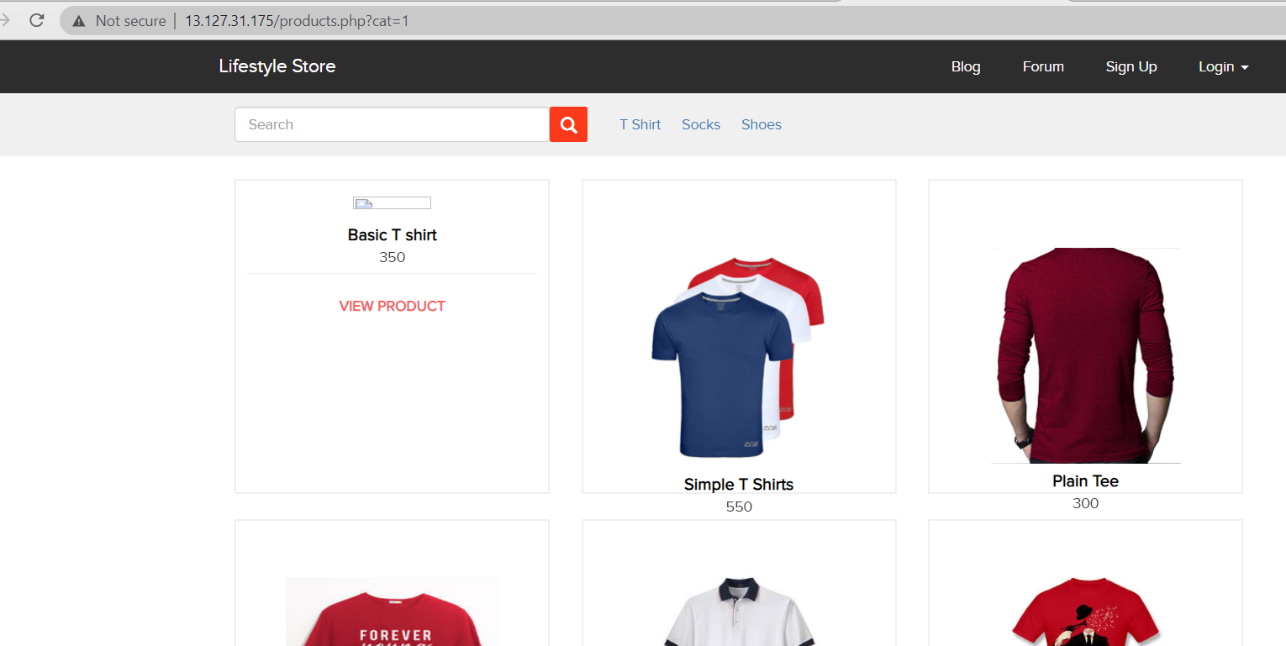
Observation:
→In the T-shirt tab, we can see GET parameter cat= 1 in URL.

Slide 7
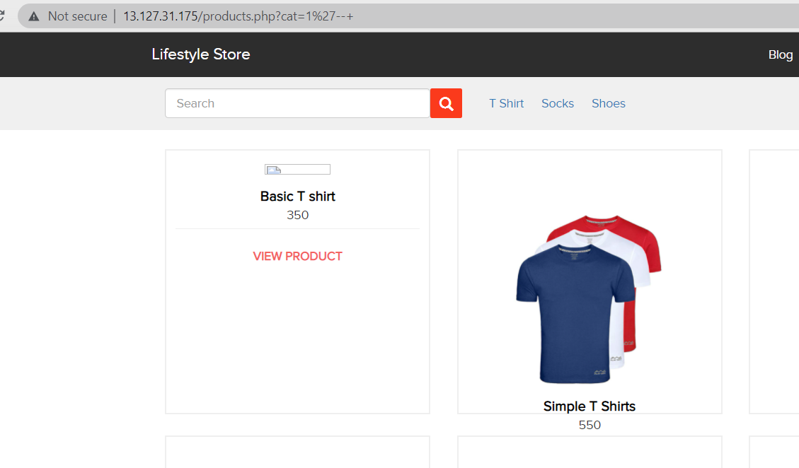
Observation:
After changing URL to products.php?cat=1‘ , we get MySQL error(screenshot 1).
And then we change it to and error is now removed confirming sql injection(screenshot 2).
Screenshot 1
Screenshot 2

Slide 8
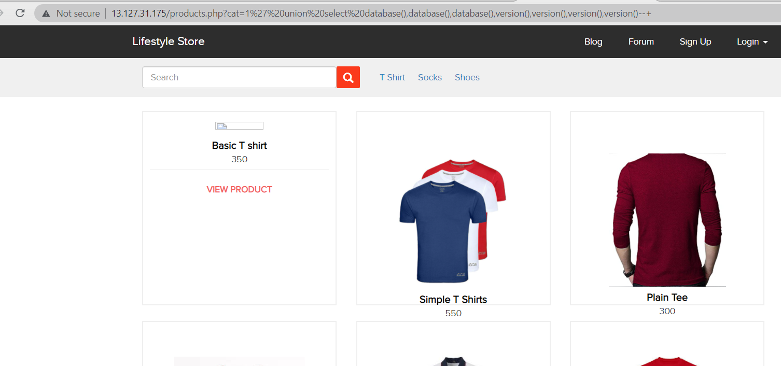
Proof Of Concept (PoC)
Attacker can execute SQL commands as shown below. Here we have used the payload below to extract the name of database and MySQL version information:

Slide 9
Business Impact – Extremely High
Using this vulnerability, attacker can execute arbitrary SQL commands on Lifestyle store server and gain complete access to internal databases along with all customer data inside it.
Below is the screenshot of users table which shows user credentials being leaked that too in plain text without any hashing/encryption.
Attacker can use this information to login to admin panels and gain complete admin level access to the website which could lead to complete compromise of the server and all other servers connected to it.

Slide 10
Recommendation
Take the following precautions to avoid exploitation of SQL injections:
Whitelist User Input: Whitelist all user input for expected data only. For example if you are expecting a flower name, limit it to alphabets only upto 20 characters in length. If you are expecting some ID, restrict it to numbers only
Prepared Statements: Use SQL prepared statements available in all web development languages and frameworks to avoid attacker being able to modify SQL query
Character encoding: If you are taking input that requires you to accept special characters, encode it. Example. Convert all ‘ to \’ , “ to \”, \ to \\. It is also suggested to follow a standard encoding for all special characters such has HTML encoding, URL encoding etc
Do not store passwords in plain text. Convert them to hashes using SHA1 SHA256 Blowfish etc
Do not run Database Service as admin/root user
Disable/remove default accounts, passwords and databases.
Assign each databases user only the required permission and not all permissions.

Slide 11
REFERENCES
https://www.owasp.org/index.php/SQL_Injection
https://en.wikipedia.org/wiki/SQL_injection

Slide 12
Access by OTP Bypass
ACCESS VIA OTP BYPASS | On the login tab of the website, the three digit otp allowing brute forcing and reset the password for access. AFFECTED URL: http://13.127.197.193/reset_password/admin.php AFFECTED PARAMETERS: OTP (GET parameters) PLAYLOAD USED: OTP = 224

Slide 13
Access by OTP Bypass
ACCESS VIA OTP BYPASS | The coupon code at the below URL can be bruteforced. AFFECTED URL: AFFECTED PARAMETERS: apply_coupon(POST parameters) PLAYLOAD USED: UL-1056

Slide 14
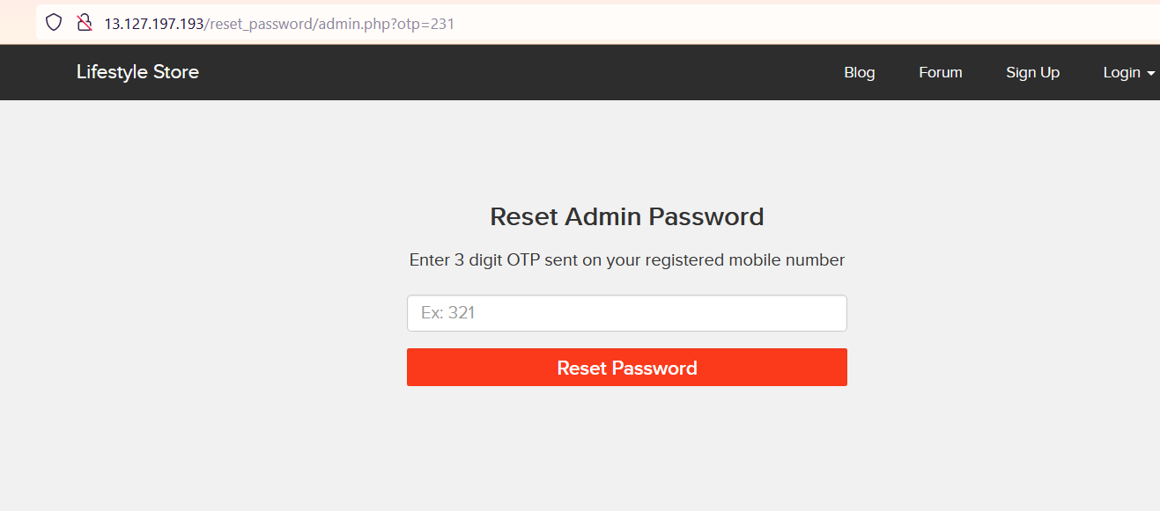
Observation:
After navigation to http://13.127.197.193/reset_password/admin.php? . We can reset password via OTP. Enter any random otp while capturing requests in local proxy.

Slide 15
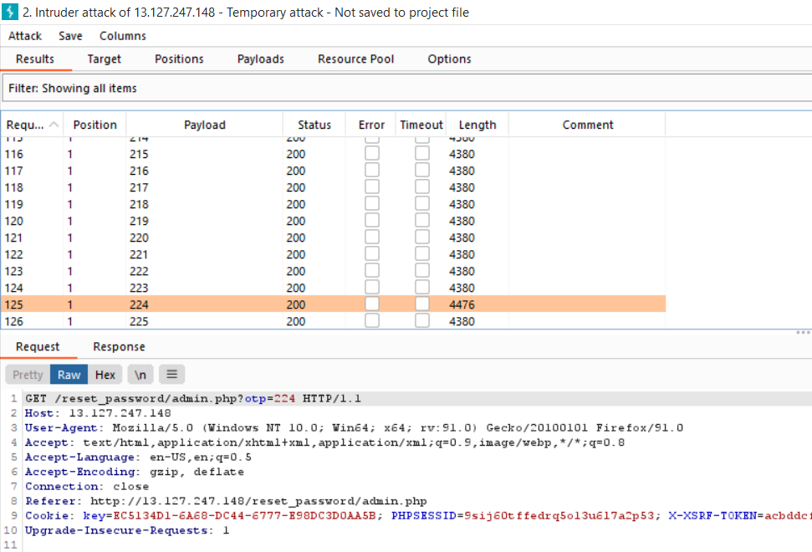
Observation:
On brute forcing the 3 digit OTP, under the length section, the value which distinct from other yields the correct otp - 224 (screenshot 1)
Logged in with new password.

Slide 16
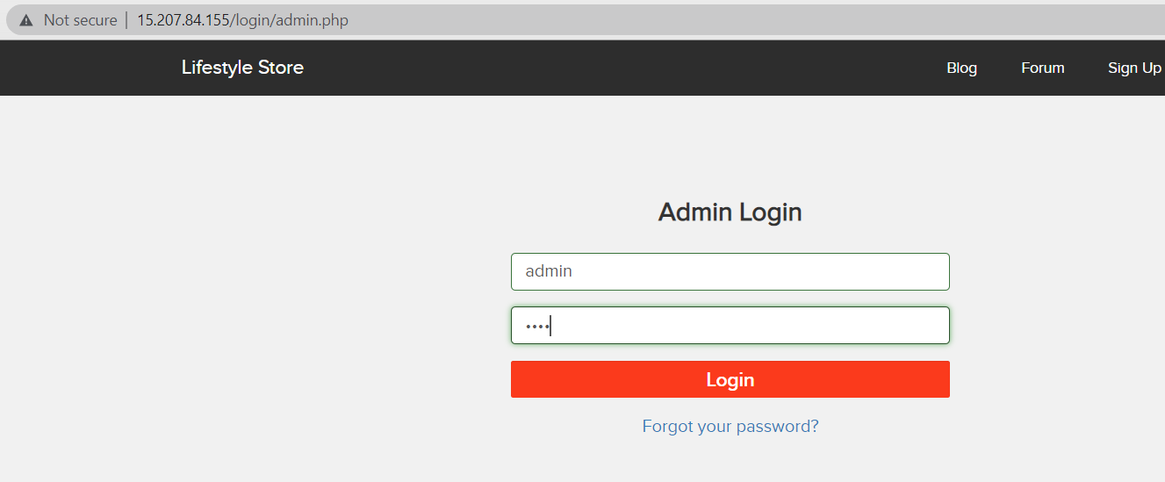
Observation:
We will be navigated to the reset password page. Here to change the password (screenshot 1).
Navigate to Enter username-admin and password (screenshot 2).

Slide 17
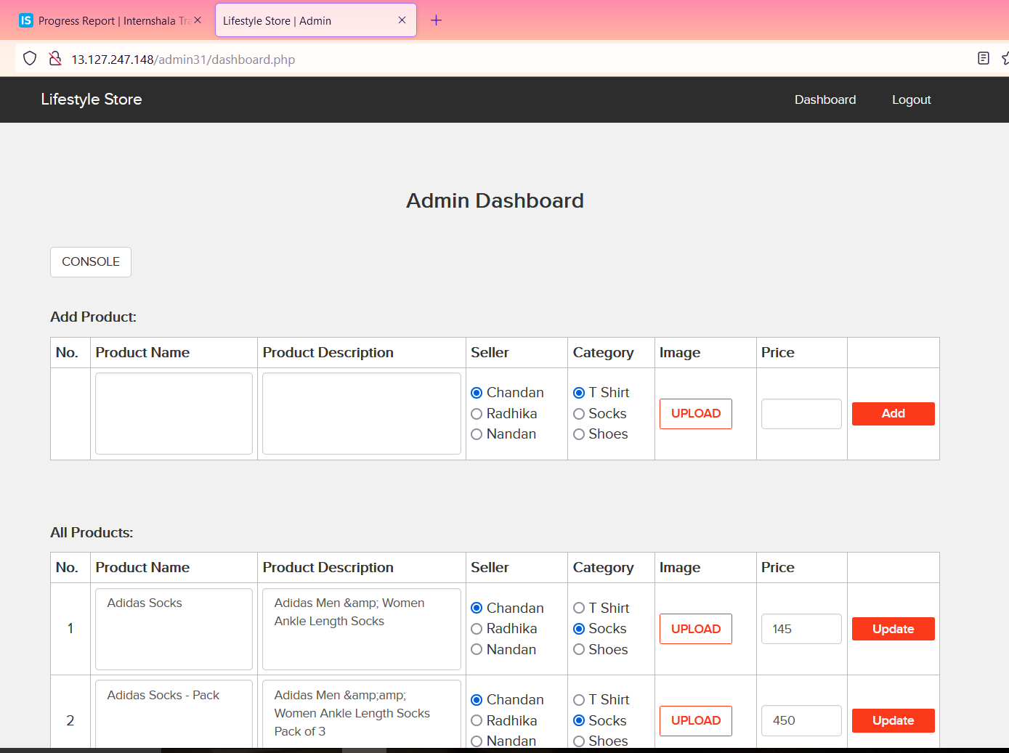
Observation:
We will be redirected to the admin dashboard where we can see the details of all the users, sellers and customers.

Slide 18
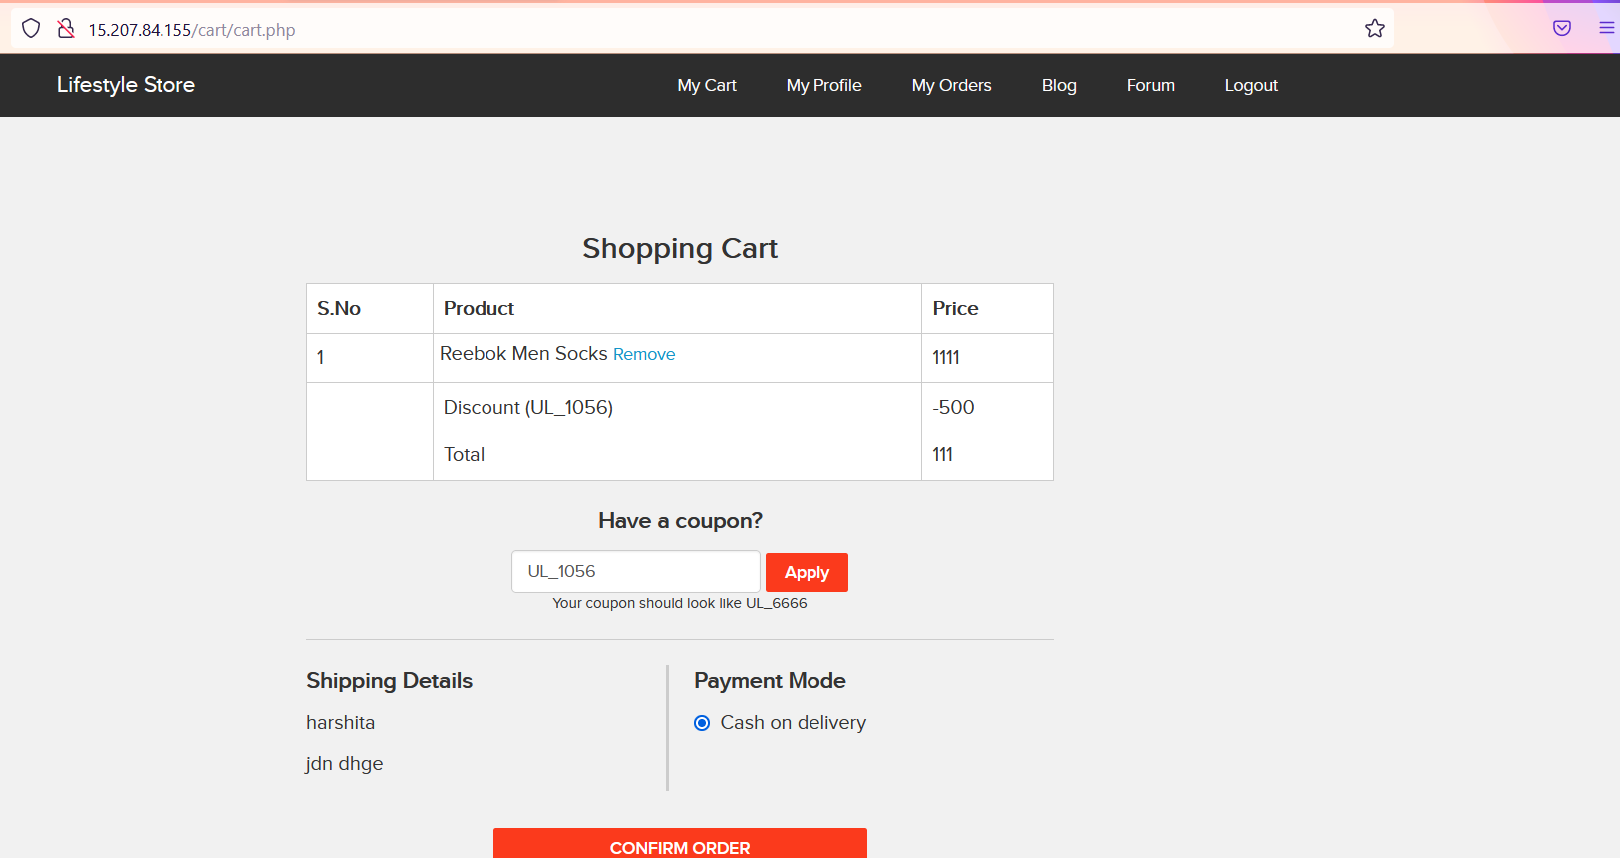
Proof of Concept (PoC)
At URL http://15.207.84.155/cart/cart.php coupon code- UL-1056 is applied.

Slide 19
Business Impact- Extremely High
A malicious hacker can gain access to any account and change the information about the products. This may lead to defamation of the seller and the website which the customer trusts.
Attacker once login can then carry out actions on behalf of the admin which could lead to serious loss to any user.

Slide 20
Recommendation:
Take the following precautions:
Use proper rate- limiting checks on the no of OTP checking and generation requests.
Implement anti-bot measures such as ReCAPTCHA after multiple incorrect attempts.
OTP should expire after certain amount of time like 2 minutes.
OTP should be atleast 6 digit and alphanumeric for more security.

Slide 21
References:
https://www.owasp.org/index.php/Testing_Multiple_Factors_Authentication_(OWASP-AT-009)
https://www.owasp.org/index.php/Blocking_Brute_Force_Attacks

Slide 22
ACCESS AS ADMIN
ACCESS AS ADMIN (CRITICAL) | Below mentioned URL is vulnerable to Arbitary file upload and making other admin level changes. AFFECTED URL: http://13.127.247.148/wondercms/loginURL

Slide 23
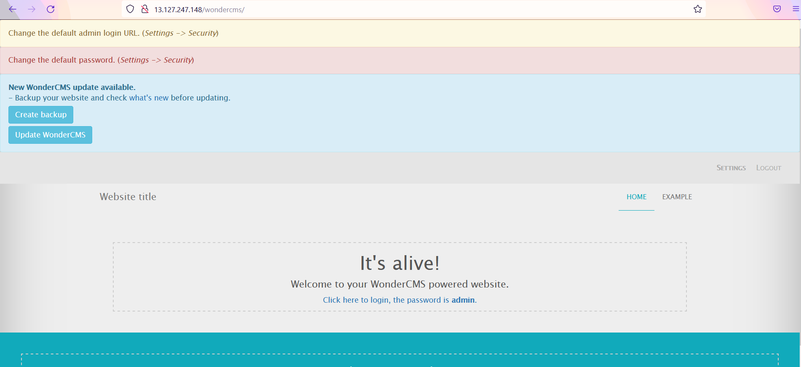
Observations:
When we navigate to http://13.127.247.148/wondercms/ , we get the password on page and login as : admin in the url http://13.127.247.148/wondercms/loginURL

Slide 24
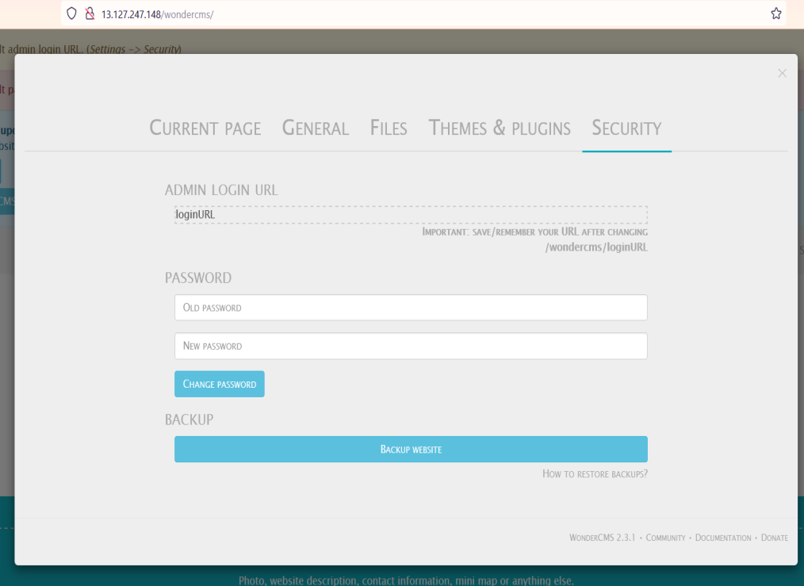
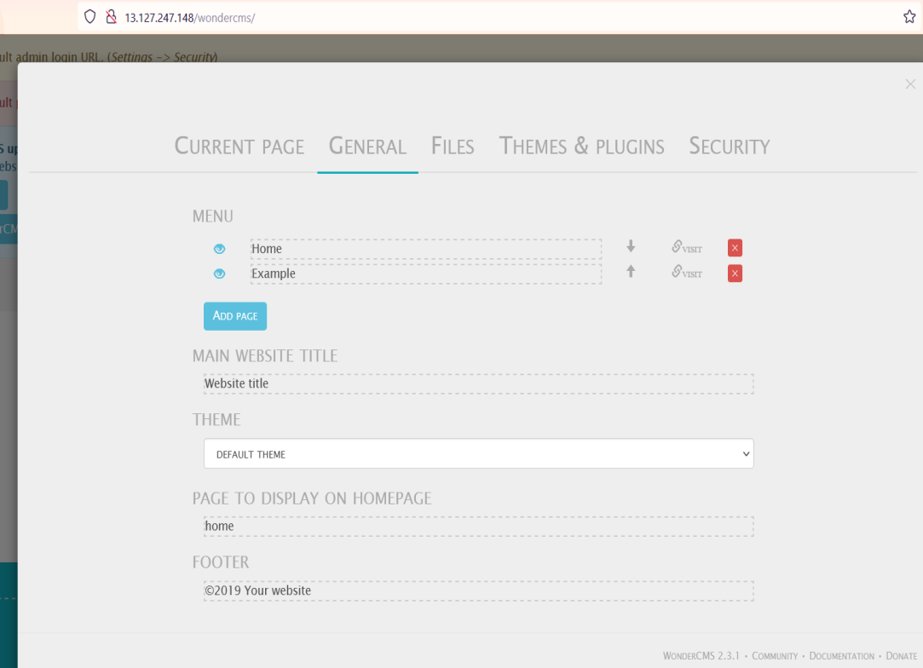
Proof of Concept (PoC)
Hacker can change the admin login password making the actual unable to login the next time. Hacker can also add and delete pages. Hacker can access all settings.

Slide 25
Business Impact- Extremely High
Using this vulnerability, the attacker can get complete access to the blog of the website.
The attacker can change the password or even change the url of the admin panel and restrict the admin to acess it.
Even pages can be created and deleted along with editing.
Files can be added (without verification) and hence can be dangerous to the entire website, as the control of the entire website can be taken.

Slide 26
Recommendation
The default password should be changed and a strong password must be setup.
The admin url must also be such that its not accessible to normal users.
Password changing option must be done with 2 to 3 step verification.
Password must be at least 8 characters long containing numbers, alphanumerics, etc.
All the default accounts should be removed.
Password should not be reused.

Slide 27
References:
https://www.owasp.org/index.php/Testing for weak password change or reset functionalities (OTG-AUTHN-009)
https://www.owasp.org/index.php/Default passwords
https://www.us-cert.gov/ncas/alerts/TA13-175A

Slide 28
UNAUTHORISED ACCESS TO CUSTOMER DETAILS
Unauthorised access to customer details (critical) | The below mentioned login page allows us to change the password without verification and view detail of other customers (CSRF). AFFECTED URL: http://13.127.247.148/reset_password/customer.php Reset password button (POST parameter). We can also change the user’s account details. AFFECTED URL: http://13.127.247.148/profile/2/edit/ AFFECTED PARAMETERS: Update button (POST parameter).

Slide 29
UNAUTHORISED ACCESS TO CUSTOMER DETAILS
Unauthorised access to customer details (critical) | Similarly after gaining access over the account, hacker can remove, add or even confirm the items in cart (CSRF). AFFECTED URL: http://15.207.84.155/cart/cart.php AFFECTED PARAMETERS: Remove option (POST paramter) AFFECTED URL: http://15.207.84.155/cart/cart.php AFFECTED PARAMETERS: Confirm order option (POST parameter)

Slide 30
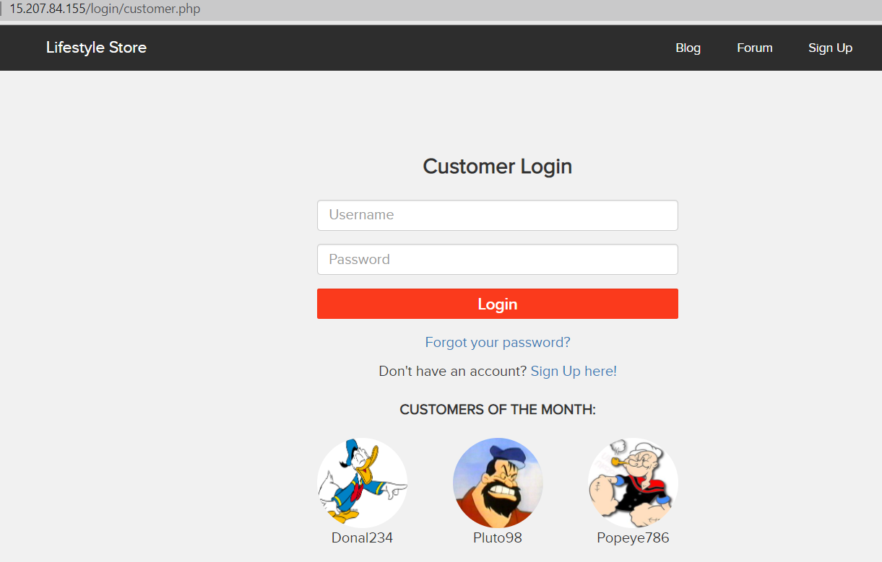
Observation:
Navigate to http://15.207.84.155/login/customer.php url. Copy any of the “customer of the month’s “ username.

Slide 31
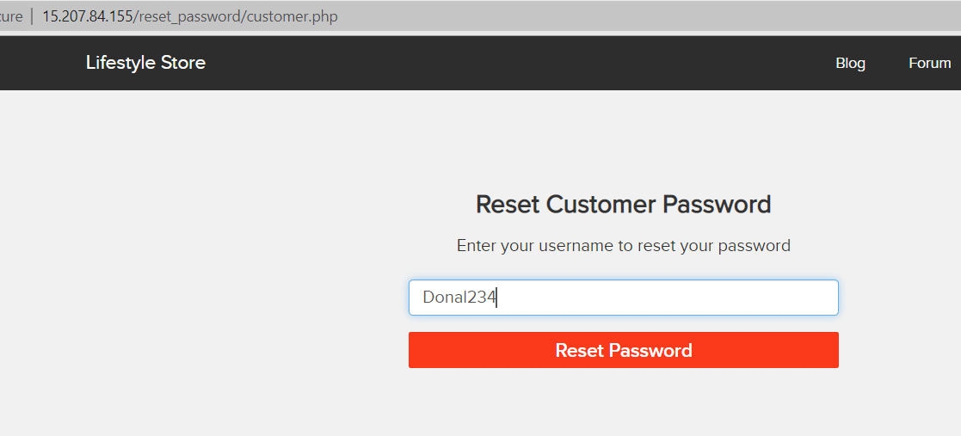
Observation:
Navigate to http://15.207.84.155/reset_password/customer.php
Paste the copies username and click on RESET PASSWORD button. We will be redirected to the given below page. Press send.

Slide 32
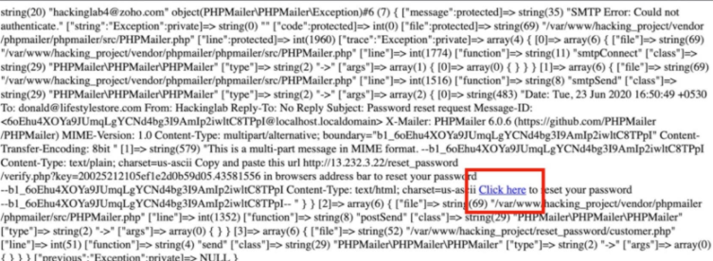
Observation:
We will be redirected to the given below page. Then click on CLICK HERE.
Then we can change the password.

Slide 33
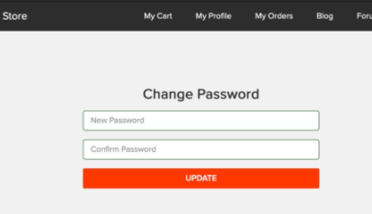
Proof of Concept (PoC)
Attacker can change the details and password of the customer easily and can place orders on user’s behalf.

Slide 34
Business Impact - Very High
A malicious hacker can gain complete access to customers's account just by clicking on forgot password. This leads to complete compromise of personal user data of the customer.
Attacker once logs in can then carry out actions on behalf of the victim which could lead to serious financial loss
To him/her. Below are the screenshots of changing the phone number of the attacked user.

Slide 35
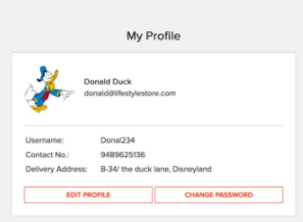

Slide 36
Recommendation
Recommendation
Implement an Anti-CSRF Token.
Do not show the customers of the month on the login page.
Use the Same Site Flag in Cookies.
check the source of request made.
Take some extra keys or tokens from the user before processing an important request.
Use 2 factor confirmations like otp, etc. for critical requests.

Slide 37
References:
https://www.netsparker.com/blog/web-security/csrf-cross-site-request-forgery/
https://digitalguardian.com/blog/how-secure-personally-identifiable-information-against-loss-or-compromise

Slide 38
ARBITARY FILE UPLOADS
This happens when applications do not implement proper file type checking and allow uploading of files of different file formats. For example, a PHP file instead of a jpeg profile picture.
ARBITARY FILE UPLOADS | The attacker can upload insecure shells and files and gain access over the entire database and login as the admin and the version is know to have vulnerabilities. AFFECTED URL: http://15.207.84.155/wondercms/ AFFECTED PARAMETERS: File upload (POST parameter) The attacker can upload files with extension other than jpeg. AFFECTED URL: AFFECTED PARAMETERS: Upload profile photo (POST parameter)

Slide 39
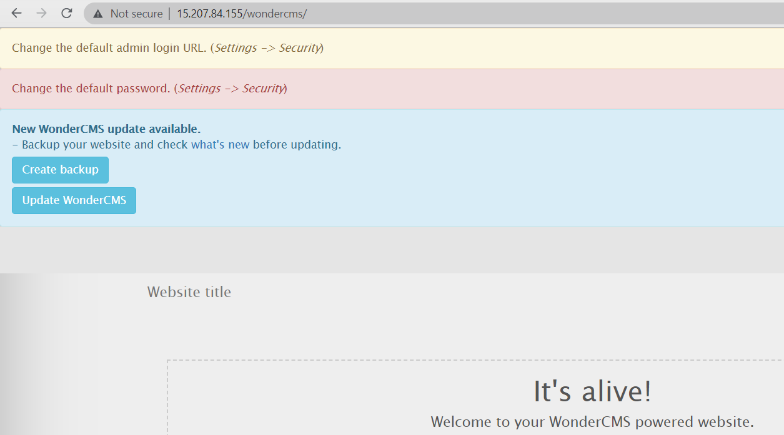
Observation:
Login using any of the user's details on the Lifestyle store and navigate to Blog tab. Now click on Login and put the password - admin.
You will see the following page and then click on Settings tab.

Slide 40
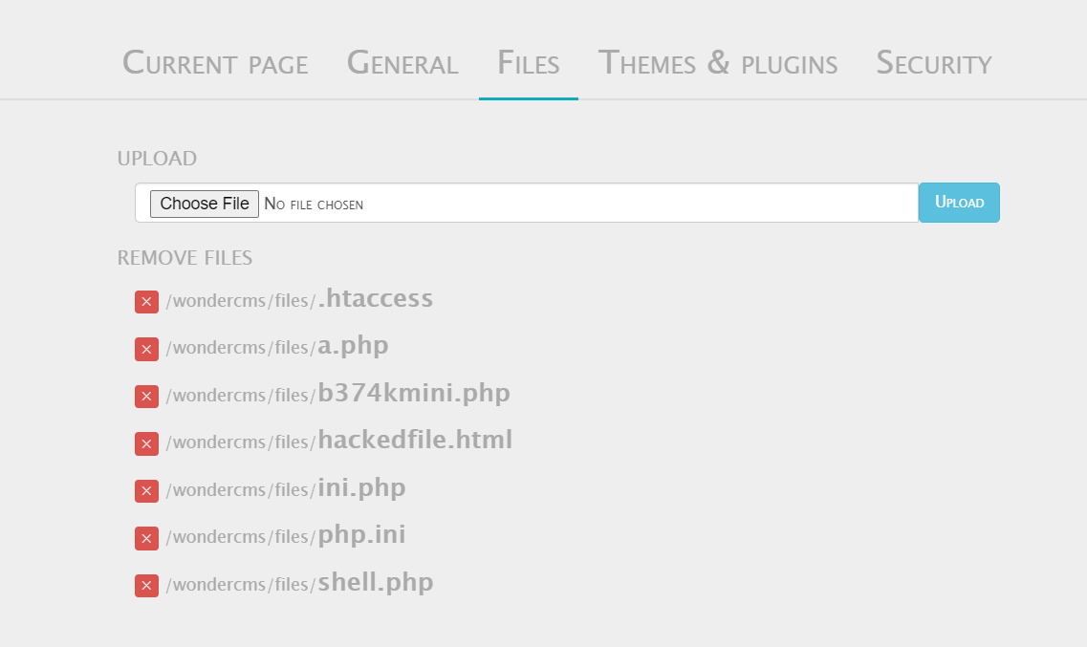
Observation:
Click on Files tab. Here hacker can upload the file like shown.
Click on the uploaded file hacked.html and it will be opened.

Slide 41
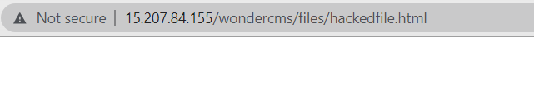
Proof of Concept (PoC)
Weak password – admin.
Arbitrary file inclusion.
Below screenshot is the result of the uploaded file.

Slide 42
Business Impact - Extremely High
Business Impact - Extremely High
Any backdoor file or shell can be uploaded to get access to the uploaded file on remote server and data
can be exfiltrated. The presence of an actual malicious file can compromise the entire system leading to system takeover/data stealing

Slide 43
Recommendation
Change the Admin password to something strong and not guessable.
The application code should be configured in such a way, that it should block uploading of malicious files extensions such as exe/ php and other extensions with a thorough server as well as client validation. CVE ID allocated: CVE-2017-14521.
Rename the files using a code, so that the attacker cannot play with file names.
Use static file hosting servers like CDNs and file clouds to store files instead of storing them on the application server itself.

Slide 44
References
https://www.owaso.org/index.php/Unrestricted-File-Upload
https://www.opswot.com/blog/file-upload-protection-best-practices

Slide 45
Cross Site Scripting
This happens when a user controlled input is reflected somewhere else in an HTML page and is not encoded/ sanitised properly. This leads to An attacker being able to inject html code in affected page.
CROSS SITE SCRIPTING | Below mentioned parameter are vulnerable to reflected XSS. AFFECTED URL: http://15.207.84.155/products/details.php?p_id=4 AFFECTED parameters: POST button under customer review (POST parameter) PAYLOAD: <script>alert(0)</script> AFFECTED URL: http://15.207.84.155/profile/2/edit/ AFFECTED parameters: Address (POST parameter) PAYLOAD: <script>alert(0)</script>

Slide 46
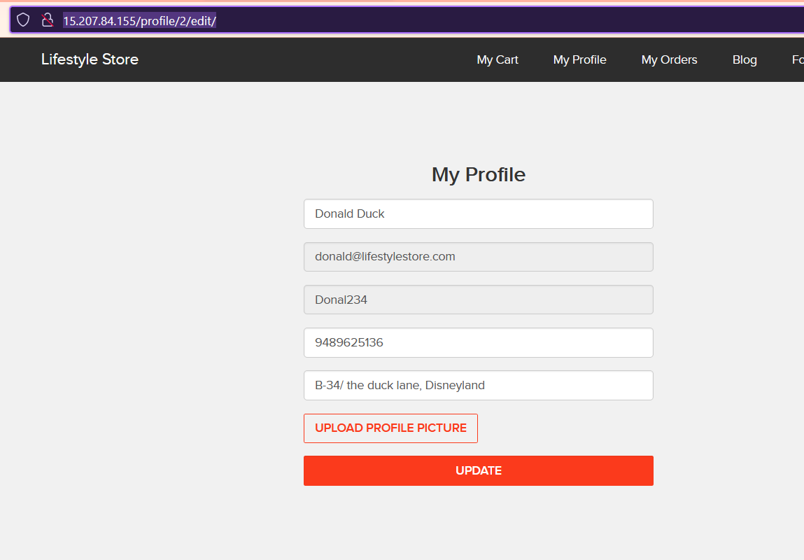
Observation:
Navigate to http://15.207.84.155/profile/2/edit/ . We will see user's details.

Slide 47
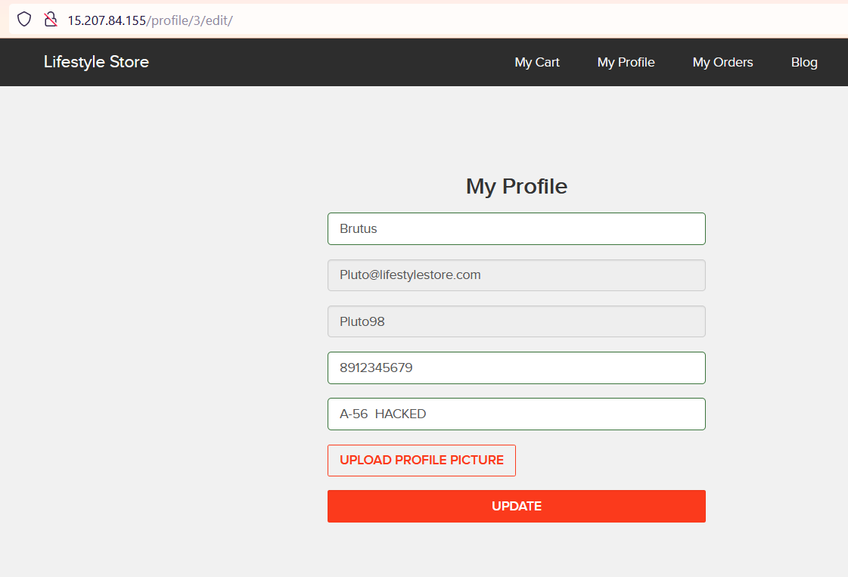
Observation:
Enter any text and click on Update, you will see it reflected in the next page and value will be in POST parameter in Address field.

Slide 48
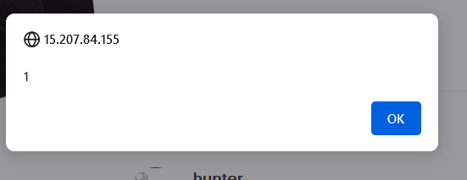
Observation:
Put this payload instead of hacked ducker: <script>alert(0)</script>
As you can see we executed custom JS causing popup.

Slide 49
Proof of Concept (PoC)

Slide 50
Business Impact - High
As attacker can inject arbitrary HTML CSS and JS via the URL, attacker can put any content on the page like phishing pages, install malware on victim's device and even host explicit content that could compromise the reputation of the organisation
All attacker needs to do is send the link with the payload to the victim and victim would see hacker controlled content on the website. As the user trusts the website, he/she will trust the content.

Slide 51
Recommendation
Take the following precautions:
Sanitise all user input and block characters you do not want. HTML entities &quot; 22 &lt; &gt; before printing them on the websiote
Convert special HTML characters like " printing them on the website.
-Apply Client Side Filters to prevent client side filters bypass.
References
https://www.owasp.org/index.php/Cross-site Scripting (XSS)
https://en.wikipedia.org/wiki/Cross-site scripting
https://www.w3schools.com/html/html_entities.asp

Slide 52
UNAUTHORISED AVAIIABILITY OF DETAILS
UNAUTHORISED AVAIIABILITY OF DETAILS – (Severe) | The show MY ORDERS session is vulnerable from an Insecure Direct Object Reference (IDOR) that allows attacker to see to anyone user details. AFFECTED URL: http://15.207.84.155/orders/orders.php?customer=16 AFFECTED parameters: Customer (GET parameters) PAYLOAD USED- 15.207.84.155/orders/orders.php?customer=18

Slide 53
UNAUTHORISED AVAIIABILITY OF DETAILS
UNAUTHORISED AVAIIABILITY OF DETAILS – (Severe) | Similarly other vulnerable urls are given below. AFFECTED URL: 15.207.84.155/orders/orders.php?customer=18 15.207.84.155/orders/orders.php?customer=16 15.207.84.155/orders/orders.php?customer=2 15.207.84.155/orders/orders.php?customer=14 15.207.84.155/orders/orders.php?customer=9 15.207.84.155/orders/orders.php?customer=5

Slide 54
UNAUTHORISED AVAIIABILITY OF DETAILS
UNAUTHORISED AVAIIABILITY OF DETAILS – (Severe) | The show MY ORDERS session is vulnerable from an Insecure Direct Object Reference (IDOR) that allows attacker to see to anyone Bill details. AFFECTED URL: http://15.207.84.155/profile/3/edit/ AFFECTED parameters: User_id GET parameter PAYLOAD USED- http://15.207.84.155/profile/2/edit/

Slide 55
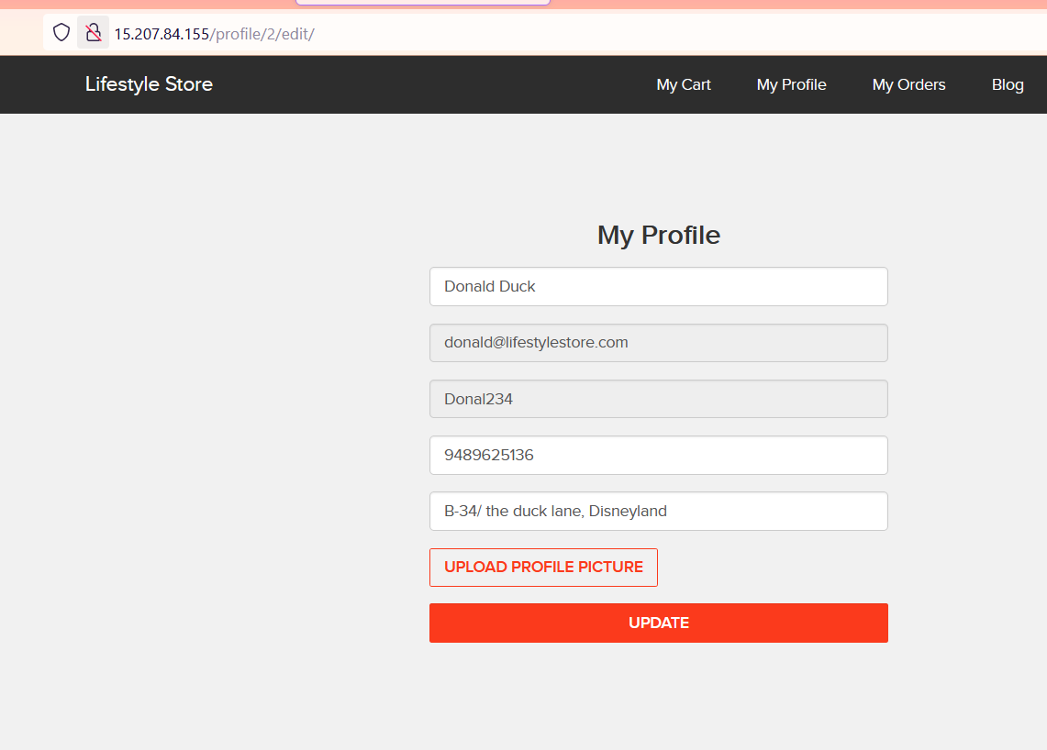
Observation
Login using any customer of the month's details. Then navigate to the below link http://15.207.84.155/profile/3/edit/
.Now remove 3 and insert 2 in the url like shown in the given screenshot and you will see the details of another user.

Slide 56
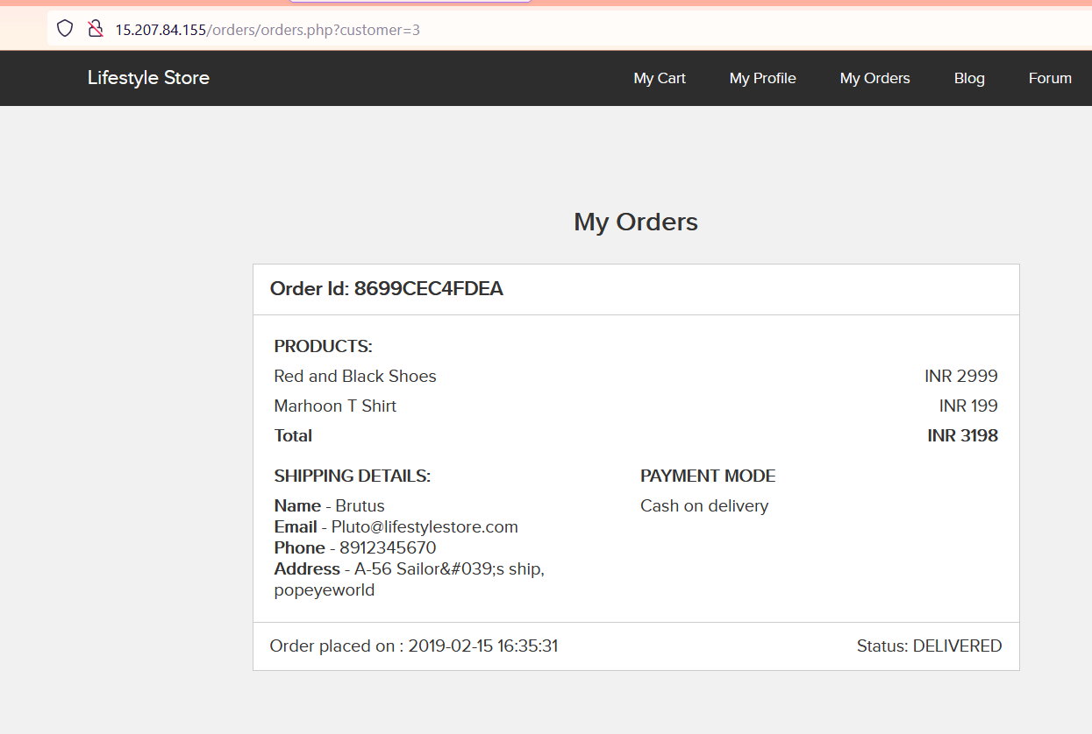
Proof of Concept PoC
Below is the screenshot of the bill details of another user accessed from attacked user's account.

Slide 57
Business Impact - Extremely High
A malicious hacker can read bill information and account details of any user just by knowing discloses critical billing information of users including
Mobile Number
Bill Number
Billing Period
Bill Amount and Breakdown
Phone no, and email address
Address
This can be used by malicious hackers to carry out targeted phishing attacks on the users and the information can also be sold to competitors/blackmarket.
Moreover, as there is no ratelimiting checks, attacker can bruteforce the user_id for all possible values and get bill information of each and every user of the organization resulting is a massive information leakage

Slide 58
Recommendation
Take the following precautions:
Implement proper authentication and authorisation checks to make sure that the user has permissions to the data he/she is requesting
Use proper rate limiting checks on the number of request comes from a single user in a small amount of time
Make sure each user can only see his/her data only
References
https://www.cwasp.org/index.phonsecure Configuration Management
https://www.awasa.org/index.php/Top 10 2013-A4-Insecure Direct Obiect References

Slide 59
INFORMATION DISCLOSURE DUE TO DEFAULT PAGES
DIRECTORY LISTING (MODERATE) | Below mentioned urls disclose server information. AFFECTED URL: http://13.127.247.148/phpinfo.php http://13.127.247.148/robots.txt http://13.127.247.148/static/images/ http://13.127.247.148/composer.ison http://13.127.247.148/composer.lock

Slide 60
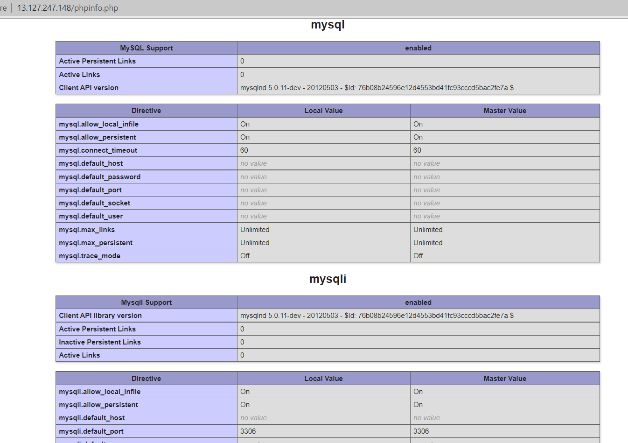
OBSERVATION
Navigate to http://13.127.247.148/phpinfo.php and we will see the below page.

Slide 61
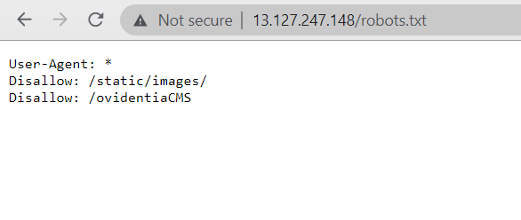
Observation
Navigate to and we will see the below page.
Next we can navigate to any listed files.

Slide 62
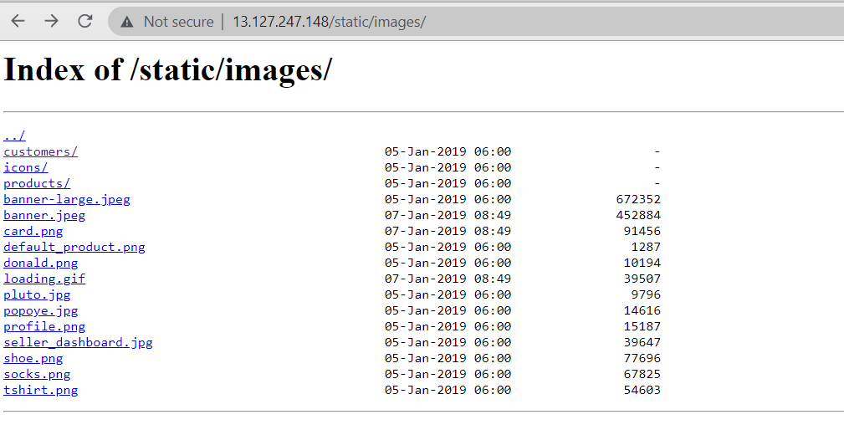
Proof of Concept (PoC)

Slide 63
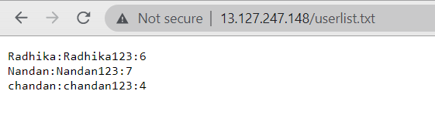
Proof of Concept (PoC)

Slide 64
Business Impact - Moderate
Although this vulnerability does not have a direct impact to users or the server, though it can aid the attacker with information about the server and the users. Information Disclosure due to default pages are not exploitable in most cases, but are considered as web application security issues because they allows malicious hackers to gather relevant information which can be used later in the attack lifecycle, in order to achieve more than they could if they didn't get access to such information.

Slide 65
Recommendation
Take the following precautions.
Disable all default pages and folders including server-status and server-info. Multiple security checks enabled on important directories.
References
https://www.netsparker.com/blog/web-security/information-disclosure-issues-attacks/
https://www.netsparker.com/web-vulnerability-scanner/vulnerabilities/information-disclosure-phpinfo/

Slide 66
OPEN REDIRECTION
OPEN REDIRECTION (SEVERE) | The LANG button of the site is vulnerable to open redirection. AFFECTED URL: http://15.207.84.155/?includelang=lang/fr.php http://15.207.84.155/?includelang=lang/en.php AFFECTED PARAMETER: Lang (GET parameters) PAYLOAD USED: http://15.207.84.155/?includelang=https://google.com/?lang/fr.php

Slide 67
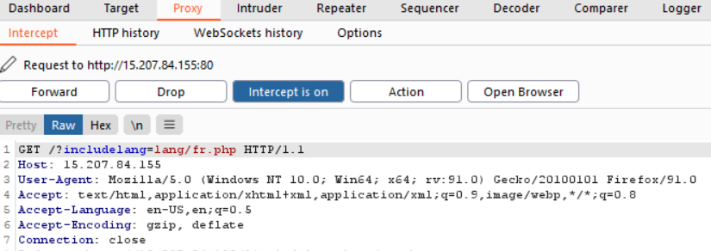
Observation
Go to http://5.207.84.155/ and in LANG, we click on french and engish vice versa.
Capture the request in local proxy.

Slide 68
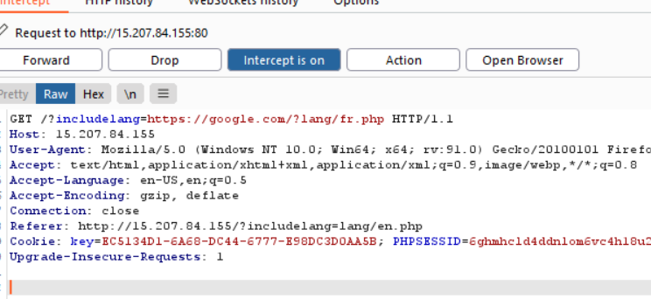
Observation
After editing the request to GET /?includelang=https://google.com/?lang/fr.php HTTP/
Pass this request in browser. We can now see google.

Slide 69
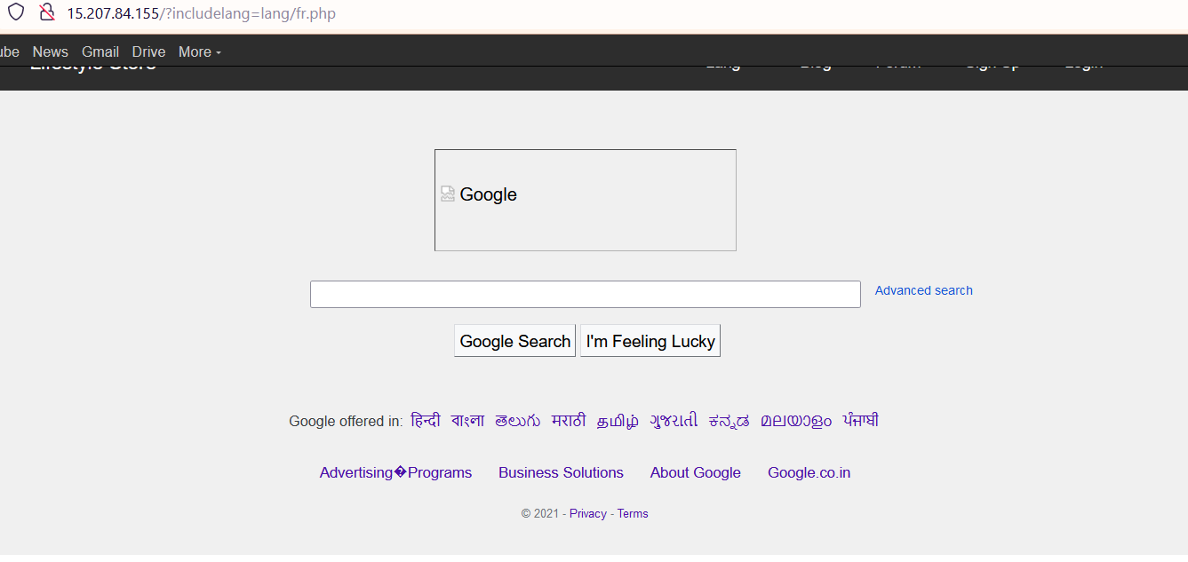
Proof of Concept (PoC)

Slide 70
Business Impact – Extremely High
An http parameter may contain a URL value and could cause the web application to redirect the request to the specified URL. By modifying the URL value to a malicious site, an attacker may successfully launch a phishing scam and steal user credentials. Because the server name in the modified link is identical to the original site, phishing attempts have a more trustworthy appearance.
Recommendation
Disallow Offsite Redirects.
If you have to redirect the user based on URLs, instead of using untrusted input you should always use an ID which is
internally resolved to the respective URL.
If you want the user to be able to issue redirects you should use a redirection page that requires the user to click on the
link instead of just redirecting them.
You should also check that the URL begins with http:// or https:// and also invalidate all other URLs to prevent the use of
malicious URIs such as javascript:

Slide 71
References
https://cwe.mitre.org/data/definitions/601.html
https://www.hacksplaining.com/prevention/open-redirects

Slide 72
CONFIGURATION FLAWS
CONFIGURATION FLAWS (SEVERE) | A flaw in your security settings, like failing to auto-encrypt your files, could leave your entire network and every device connected to it vulnerable to an attack. AFFECTED URL: http://15.207.84.155/

Slide 73
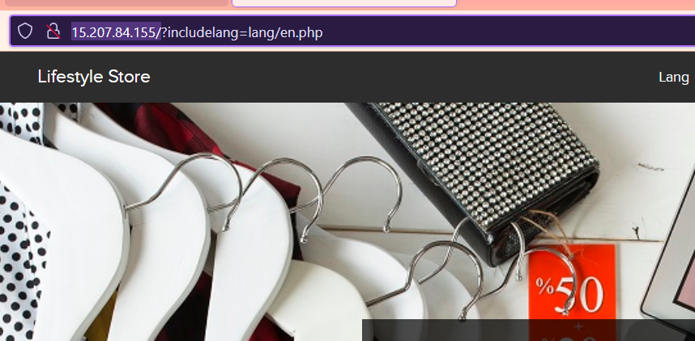
Observation

Slide 74
Business Impact - High
Security is almost halved in http providing easy man-in-the-middle attack and others which makes it easy for attacker to go through the data transmitted over the internet.
Recommendation
Use https instead of http as the protocol.
References
https://www.owasp.org/index.php/Category:Cryptographic_Vulnerability
https://www.w3.org/Protocols/rfc2616/rfc2616-sec15.html

Slide 75
WEAK PASSWORD
WEAK PASSWORD (SEVERE) | Below url have weak passwords. AFFECTED URL: http://15.207.84.155/wondercms/ http://15.207.84.155/userlist.txt

Slide 76
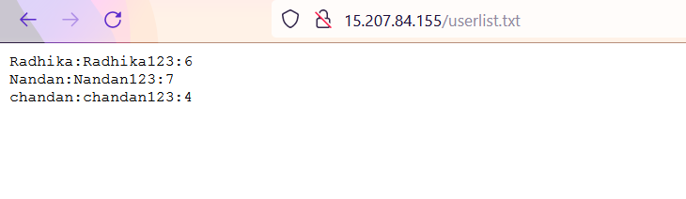
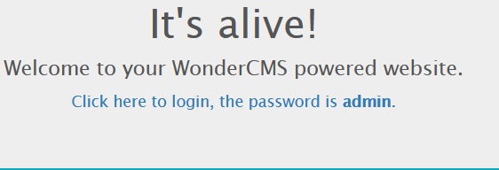
Observation
The passwords of the given url of the site is very common and easily predictable.

Slide 77
Business Impact - High
Easy, default and common passwords make it easy for attackers to gain access to their accounts illegal use of them and can harm the website to any extent after getting logged into privileged accounts.
Recommendation
There should be password strength check at every creation of an account.
There must be a minimum of 8 characters long password with a mixture of numbers ,alphanumerics ,special characters ,etc.
There should be no repetition of password ,neither on change nor reset.
The password should not be stored on the web, rather should be hashed and stored.

Slide 78
References
https://www.acunetix.com/blog/articles/weak-password-vulnerability-common-think/
https://www.owasp.org/index.php/Testing_for_Weak_password_policy_(OTG-AUTHN-007)

Slide 79
PERSONALLY INDENTIFIABLE INFORMATION
PERSONALLY INDENTIFIABLE INFORMATION (LOW) | Below url gives the irrelevant details of seller (PII). AFFECTED URL: Http://15.207.84.155/products/details.php?p_id=2 http://15.207.84.155/products/details.php?p_id=6

Slide 80
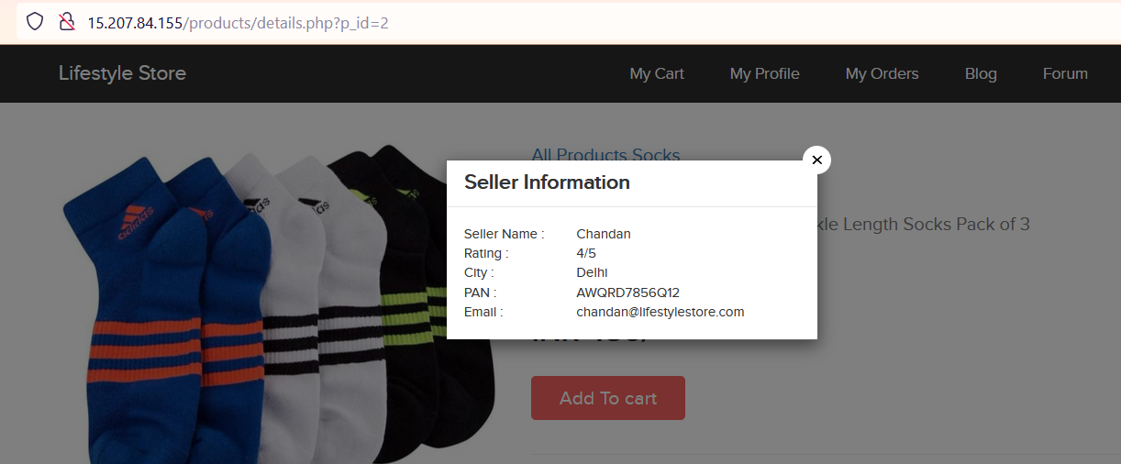
Observation
Click on seller info option, we will get details of seller and some of them which are not even required eg. Pan card number.

Slide 81
Business Impact – Moderate
There is no direct business impact in this case ,but this amount of information can definitely lead to social engineering attacks on the seller and can indirectly harm the business.
The information could be sold to rival business companies . Sellers can be unnecessarily be pranked.
Recommendation
Only name and email is sufficient as far as the query or help is concerned.
References
https://digitalguardian.com/blog/how-secure-personally-identifiable-information-against-loss-or-compromise

Slide 82
IMPROPER SERVER SIDE FILTER
IMPROPER SERVER SIDE FILTER (LOW) | Below url have improper server side filter. AFFECTED URL: http://15.207.84.155/profile/16/edit/ AFFECTED PARAMETER: Contact number (POST parameters) PAYLOAD USED: 9111111111

Slide 83
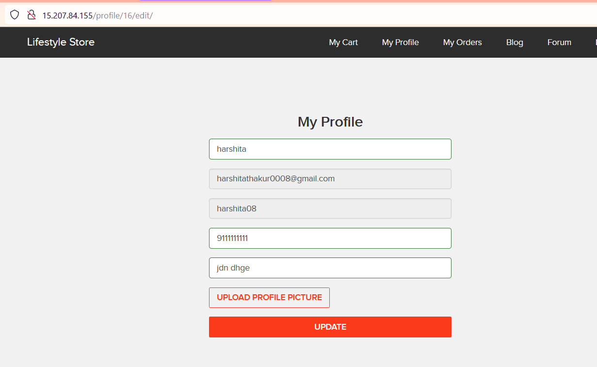
Observation
After loggin as a customer, we entered the contact number of correct length but it actually doesn’t exist, it is accessed.

Slide 84
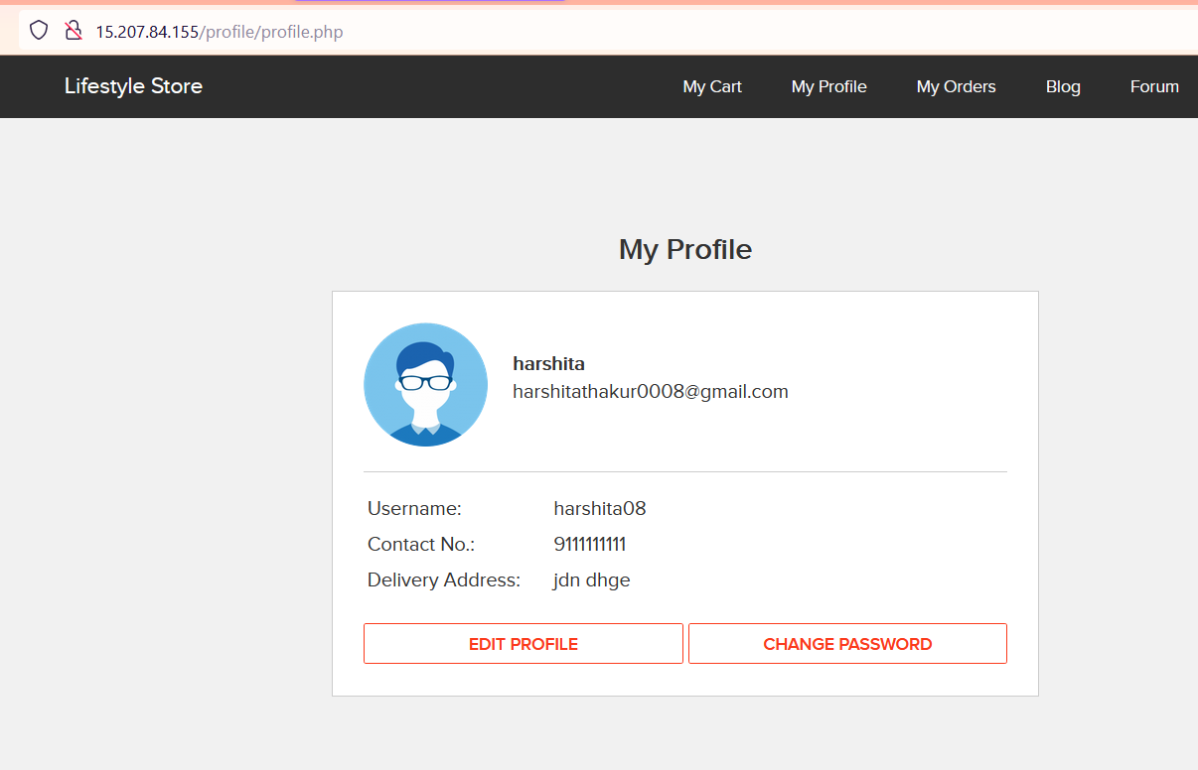
Proof of Concept (PoC)
Now we can see that our invalid contact number is updated in the profile.

Slide 85
Business Impact - Low
The data provided by the user ,if incorrect, is not a very big issue but still must be checked for proper validatory information.
Recommendation
Implement all critical checks on server side code only.
All business logic must be implemented and checked on the server code. This include user input, the flow of application and even the URL/modules a user is supposed to access or not.
References
http://projects.webappsec.org/w/page/13246933/Improper%20Input%20Handling
https://www.owasp.org/index.php/Unvalidated_Input

Slide 86
THANK YOU
For further clarifications/patch assistance, please contact: 9873187694

